Slide 1
E-BL: Dream or Reality?
Presented by Yossi Bar – Traffic Manager

Slide 2
Background
The documentation process in the Shipping Industry is one of the most outdated processes of our time
This is especially true regarding the B/L that covers the transaction as there has been no change in the process since the last century
What is known as Rotterdam Rules is pending approval for more than 20 years.
Shipping is an Industry that uses large amounts of paper for Bs/L, Invoices, Notifications, Certificates and other required documentation
It is estimated that millions of paper Bs/L are issued annually, most of them with a minimum of 3 originals

Slide 3
The Main Challenges
The main concerns regarding the B/L are:
Who is the owner of the cargo at any given time?
Where are the Original Bs/L?
Do all the required endorsements exists and are they correct?

Slide 4
ZIM / WAVE E-B/L
ZIM together with Wave Ltd. are leading the industry in paperless trade by replacing the traditional paper B/L with a secure platform for transporting cargo with an E-B/L
The aim is to simplify the process and prevent the problems which occur with paper Bs/L such as:
Loss of documents
Delays in receiving documents
Frauds and forgeries
Disputes of title
Piles of paper and paper waste

Slide 5
Additional Benefits of E-B/L
Negotiability: The Blockchain technology allows the B/L to be 100% negotiable and confidential
Endorsement: The platform allows the endorsement to each entity that is part of the platform (unlimited number of participants)
Add Documents: The Platform allows each user in the chain to include additional documents (such as supplier invoice, packing list etc) without allowing any change in the B/L data
The Carrier continues to work normally and prepares the B/L in its local documentation system
Simple: The customer simply needs to download the application and start working
Privacy: All documents are private and encrypted and are sent directly between the commercially related parties
Decryption can only be made by the addressee. Wave does not have any access to any commercial information
Receiving and sending commercial documents are done directly from the desktop which eliminates documentation transportation costs
Control: At any given time the B/L is controlled by one entity only

Slide 6
Basic Requirements
In order for the B/L to be endorsed the bill must be negotiable
All parties involved in the transaction should download the application

Slide 7
E-BL Process
ZIM POL Agent
Shipper
ZIM POD Agent
Consignee or Bank
Receiver

Slide 8
E-BL Process
Carrier agent at POL Creates and uploads B/L and endorses to Shipper
Shipper adds relevant documents and endorses to the CNEE Bank
The bank, upon verification of terms of L/C and ensuring all financial aspects between the Shipper and Receiver have been finalized, endorses the B/L to the Receiver
The Receiver verifies the B/L and transfers to the Carriers agent at the POD
Carrier Agent at POD documents the submission of OBL and releases the D/O to the customer

Slide 9
E-BL Process
In the future the Customs Authorities and Port Authorities can be included in the workflow
This will not change the current BL flow - only digitize it

Slide 10
E-BL Process
The Carrier issues a B/L using their own local Documentation system.
The Carrier uploads the PDF of the B/L into the Wave application which creates an E-B/L that contains:
The E-B/L information
Metadata (initial endorsement chain transaction)
Digital signature that locks the E-B/L from future changes
The E-B/L is then endorsed to the next party by adding an email address and pressing “send”
When sending an E-B/L the Wave application simultaneously sends the E-B/L to the recipient while publishing an endorsement transaction over the Blockchain
At the end of the supply chain, the importer will surrender the E-B/L back to the Carrier who releases the D/O accordingly

Slide 11
ZIM Blockchain Pilot
The first pilot was 3 B/L’s from China to Canada
Client is Sparx Logistics HK and Sparx Logistics Canada
Simple Transaction (No Banks involved, No Authorities)
15 min technical instruction for each user (Zim Agency, Sparx HK, Sparks Canada)
Today we have a number of customers using the application

Slide 12
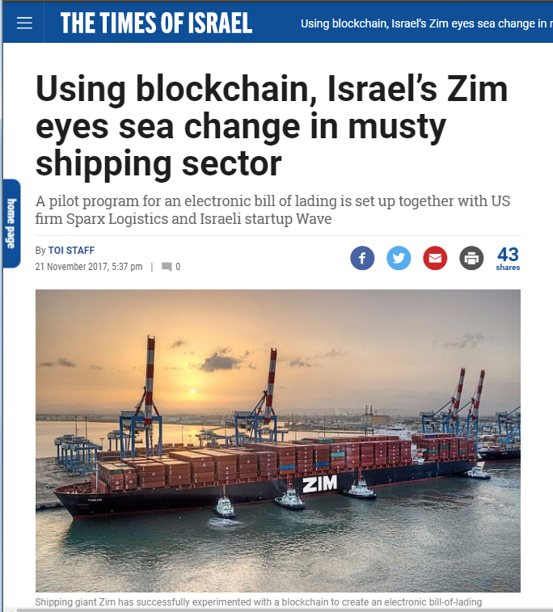
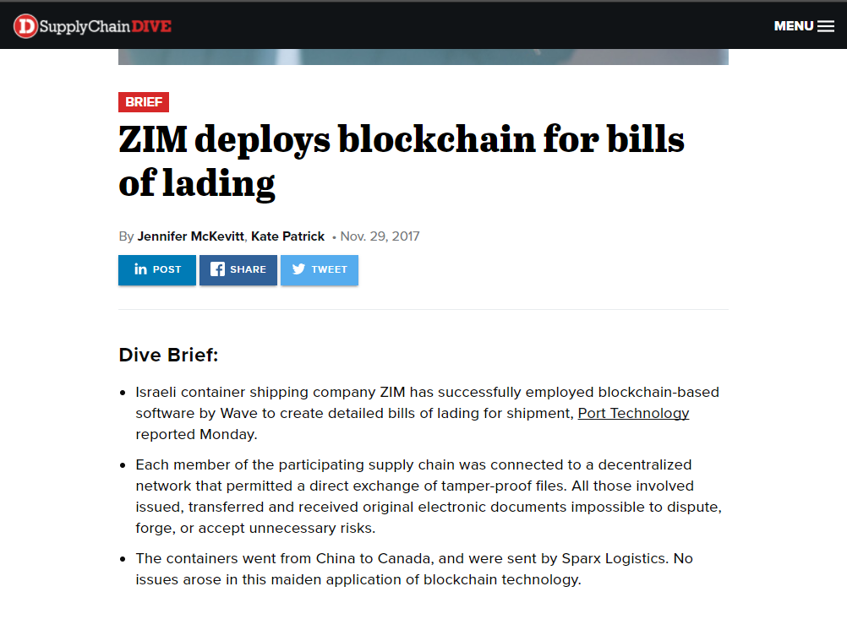
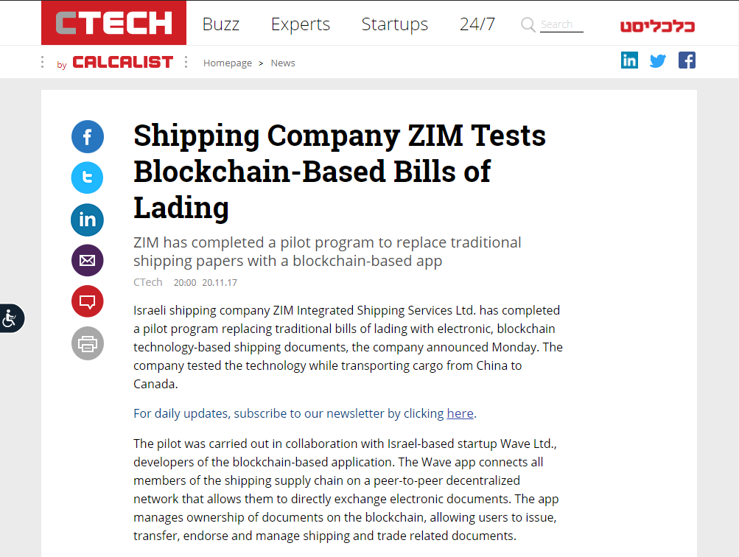
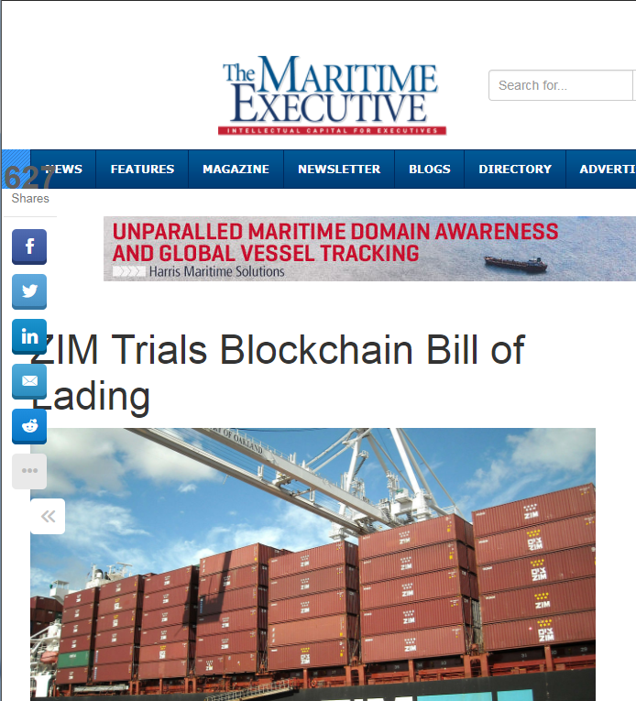
ZIM in the media

Slide 13
Future…
We finished the pilot with great success. The system is in production
WAVE is working together with various banks who are a part of the shipment to encourage their participation as well as Customs / Port Authorities worldwide
Include additional customers with more complex processes
Enhance the product

Slide 14
Thank You

